Slide 1
Podcast Plus: A Redux-Inspired Podcast App with Dynamic Themes for Android
Listen in style. Podcasting made personal
NAME: Mukesh A.B
REG NO:710422104030

Slide 2
OBJECTIVE
The goal of Podcast Plus is to provide Android users with a seamless and engaging podcast streaming experience by leveraging a Redux-inspired architecture for efficient state management. This ensures predictability, maintainability, and real-time updates across the app, enhancing overall performance. The app features dynamic themes, including light, dark, and customizable options, allowing users to personalize their interface. With an intuitive design, personalized recommendations, and offline support, Podcast Plus prioritizes user convenience and flexibility. Its modular and scalable structure ensures the app remains adaptable to future enhancements, delivering a reliable and visually appealing podcast experience.

Slide 3
MainActivity.kt
package com.example.podcastplayer
import android.content.Context
import android.media.MediaPlayer
import android.os.Bundle
import androidx.activity.ComponentActivity
import androidx.activity.compose.setContent
import androidx.compose.foundation.BorderStroke
import androidx.compose.foundation.Image
import androidx.compose.foundation.layout.*
import androidx.compose.foundation.rememberScrollState
import androidx.compose.foundation.verticalScroll
import androidx.compose.material.*
import androidx.compose.runtime.*
import androidx.compose.ui.Alignment
import androidx.compose.ui.Modifier
import androidx.compose.ui.graphics.Color
import androidx.compose.ui.res.painterResource
import androidx.compose.ui.text.font.FontWeight
import androidx.compose.ui.text.style.TextAlign

Slide 4
import androidx.compose.ui.text.style.TextAlign
import androidx.compose.ui.unit.dp
import androidx.compose.ui.unit.em
import androidx.compose.ui.unit.sp
import com.example.podcastplayer.ui.theme.PodcastPlayerTheme
class MainActivity : ComponentActivity() {
override fun onCreate(savedInstanceState: Bundle?) {
super.onCreate(savedInstanceState)
setContent {
PodcastPlayerTheme {
// A surface container using the 'background' color from the theme
Surface(
modifier = Modifier.fillMaxSize(),
color = MaterialTheme.colors.background
) {
playAudio(this)
}
}
}
}
}

Slide 5
import androidx.compose.ui.text.style.TextAlign
import androidx.compose.ui.unit.dp
import androidx.compose.ui.unit.em
import androidx.compose.ui.unit.sp
import com.example.podcastplayer.ui.theme.PodcastPlayerTheme
class MainActivity : ComponentActivity() {
override fun onCreate(savedInstanceState: Bundle?) {
super.onCreate(savedInstanceState)
setContent {
PodcastPlayerTheme {
// A surface container using the 'background' color from the theme
Surface(
modifier = Modifier.fillMaxSize(),
color = MaterialTheme.colors.background
) {
playAudio(this)
}
}
}
}
}

Slide 6
@Composable
fun playAudio(context: Context) {
Column(modifier = Modifier.fillMaxSize()) {
Column(horizontalAlignment = Alignment.CenterHorizontally, verticalArrangement = Arrangement.Center) {
Text(text = "PODCAST",
modifier = Modifier.fillMaxWidth(),
textAlign = TextAlign.Center,
color = Color(0xFF6a3ef9),
fontWeight = FontWeight.Bold,
fontSize = 36.sp,
style = MaterialTheme.typography.h1,
letterSpacing = 0.1.em
)
}
Column(modifier = Modifier
.fillMaxSize()

Slide 7
.verticalScroll(rememberScrollState())) {
Card(
elevation = 12.dp,
border = BorderStroke(1.dp, Color.Magenta),
modifier = Modifier
.padding(16.dp)
.fillMaxWidth()
.height(250.dp)
)
{
val mp: MediaPlayer = MediaPlayer.create(context, R.raw.audio)
Column(
modifier = Modifier.fillMaxSize(),
horizontalAlignment = Alignment.CenterHorizontally
) {
Image(
painter = painterResource(id = R.drawable.img),
contentDescription = null,
modifier = Modifier

Slide 8
.height(150.dp)
.width(200.dp),
)
Text(
text = "GaurGopalDas Returns To TRS - Life, Monkhood & Spirituality",
textAlign = TextAlign.Center,
modifier = Modifier.padding(start = 20.dp, end = 20.dp)
)
Row() {
IconButton(onClick = { mp.start() }, modifier = Modifier.size(35.dp)) {
Icon(
painter = painterResource(id = R.drawable.play),
contentDescription = ""
)
}
IconButton(onClick = { mp.pause() }, modifier = Modifier.size(35.dp)) {
Icon(
painter = painterResource(id = R.drawable.pause),
contentDescription = ""

Slide 9
)
}
}
}
}
Card(
elevation = 12.dp,
border = BorderStroke(1.dp, Color.Magenta),
modifier = Modifier
.padding(16.dp)
.fillMaxWidth()
.height(250.dp)
)
{
val mp: MediaPlayer = MediaPlayer.create(context, R.raw.audio_1)
Column(
modifier = Modifier.fillMaxSize(),
horizontalAlignment = Alignment.CenterHorizontally
) {
Image(
painter = painterResource(id = R.drawable.img_1),
contentDescription = null,
modifier = Modifier
.height(150.dp)
.width(200.dp)
)
Text(
text = "Haunted Houses, Evil Spirits & The Paranormal Explained | Sarbajeet Mohanty",
textAlign = TextAlign.Center,
modifier = Modifier.padding(start = 20.dp, end = 20.dp)
)
Row() {
IconButton(onClick = { mp.start() }, modifier = Modifier.size(35.dp)) {
Icon(
painter = painterResource(id = R.drawable.play),
contentDescription = ""
)
}
IconButton(onClick = { mp.pause() }, modifier = Modifier.size(35.dp)) {
Icon(
painter = painterResource(id = R.drawable.pause),
contentDescription = ""
)
}
}
}
}
Card(
elevation = 12.dp,
border = BorderStroke(1.dp, Color.Magenta),
modifier = Modifier
.padding(16.dp)
.fillMaxWidth()
.height(250.dp)
)
{
val mp: MediaPlayer = MediaPlayer.create(context, R.raw.audio_2)
Column(
modifier = Modifier.fillMaxSize(),
horizontalAlignment = Alignment.CenterHorizontally
) {
Image(
painter = painterResource(id = R.drawable.img_2),
contentDescription = null,
modifier = Modifier
.height(150.dp)
.width(200.dp)
)
Text(
text = "Kaali Mata ki kahani - Black Magic & Aghoris ft. Dr Vineet Aggarwal",
textAlign = TextAlign.Center,
modifier = Modifier.padding(start = 20.dp, end = 20.dp)
)
Row() {
IconButton(onClick = { mp.start() }, modifier = Modifier.size(35.dp)) {
Icon(
painter = painterResource(id = R.drawable.play),
contentDescription = ""
)
}
IconButton(onClick = { mp.pause() }, modifier = Modifier.size(35.dp)) {
Icon(
painter = painterResource(id = R.drawable.pause),
contentDescription = ""
)
}
}
}
}
Card(
elevation = 12.dp,
border = BorderStroke(1.dp, Color.Magenta),
modifier = Modifier
.padding(16.dp)
.fillMaxWidth()
.height(250.dp)
)
{
val mp: MediaPlayer = MediaPlayer.create(context, R.raw.audio_3)
Column(
modifier = Modifier.fillMaxSize(),
horizontalAlignment = Alignment.CenterHorizontally
) {
Image(
painter = painterResource(id = R.drawable.img_3),
contentDescription = null,
modifier = Modifier
.height(150.dp)
.width(200.dp),
)
Text(
text = "Tantra Explained Simply | Rajarshi Nandy - Mata, Bhairav & Kamakhya Devi",
textAlign = TextAlign.Center,
modifier = Modifier.padding(start = 20.dp, end = 20.dp)
)
Row() {
IconButton(onClick = { mp.start() }, modifier = Modifier.size(35.dp)) {
Icon(
painter = painterResource(id = R.drawable.play),
contentDescription = ""
)
}
IconButton(onClick = { mp.pause() }, modifier = Modifier.size(35.dp)) {
Icon(
painter = painterResource(id = R.drawable.pause),
contentDescription = ""
)
}
}
}
}
Card(
elevation = 12.dp,
border = BorderStroke(1.dp, Color.Magenta),
modifier = Modifier
.padding(16.dp)
.fillMaxWidth()
.height(250.dp)
)
{
val mp: MediaPlayer = MediaPlayer.create(context, R.raw.audio_4)
Column(
modifier = Modifier.fillMaxSize(),
horizontalAlignment = Alignment.CenterHorizontally
) {
Image(
painter = painterResource(id = R.drawable.img_4),
contentDescription = null,
modifier = Modifier
.height(150.dp)
.width(200.dp),
)
Text(
text = "Complete Story Of Shri Krishna - Explained In 20 Minutes",
textAlign = TextAlign.Center,
modifier = Modifier.padding(start = 20.dp, end = 20.dp)
)
Row() {
IconButton(onClick = { mp.start() }, modifier = Modifier.size(35.dp)) {
Icon(
painter = painterResource(id = R.drawable.play),
contentDescription = ""
)
}
IconButton(onClick = { mp.pause() }, modifier = Modifier.size(35.dp)) {
Icon(
painter = painterResource(id = R.drawable.pause),
contentDescription = ""
)
}
}
}
}
Card(
elevation = 12.dp,
border = BorderStroke(1.dp, Color.Magenta),
modifier = Modifier
.padding(16.dp)
.fillMaxWidth()
.height(250.dp)
)
{
val mp: MediaPlayer = MediaPlayer.create(context, R.raw.audio_5)
Column(
modifier = Modifier.fillMaxSize(),
horizontalAlignment = Alignment.CenterHorizontally
) {
Image(
painter = painterResource(id = R.drawable.img_5),
contentDescription = null,
modifier = Modifier
.height(150.dp)
.width(200.dp),
)
Text(
text = "Mahabharat Ki Poori Kahaani - Arjun, Shri Krishna & Yuddh - Ami Ganatra ",
textAlign = TextAlign.Center,
modifier = Modifier.padding(start = 20.dp, end = 20.dp)
)
Row() {
IconButton(onClick = { mp.start() }, modifier = Modifier.size(35.dp)) {
Icon(
painter = painterResource(id = R.drawable.play),
contentDescription = ""
)
}
IconButton(onClick = { mp.pause() }, modifier = Modifier.size(35.dp)) {
Icon(
painter = painterResource(id = R.drawable.pause),
contentDescription = ""
)
}
}
}
}
}
}
}

Slide 10
)
}
}
}
}
Card(
elevation = 12.dp,
border = BorderStroke(1.dp, Color.Magenta),
modifier = Modifier
.padding(16.dp)
.fillMaxWidth()
.height(250.dp)
)
{
val mp: MediaPlayer = MediaPlayer.create(context, R.raw.audio_1)
Column(
modifier = Modifier.fillMaxSize(),
horizontalAlignment = Alignment.CenterHorizontally

Slide 11
) {
Image(
painter = painterResource(id = R.drawable.img_1),
contentDescription = null,
modifier = Modifier
.height(150.dp)
.width(200.dp)
)
Text(
text = "Haunted Houses, Evil Spirits & The Paranormal Explained | Sarbajeet Mohanty",
textAlign = TextAlign.Center,
modifier = Modifier.padding(start = 20.dp, end = 20.dp)
)
Row() {
IconButton(onClick = { mp.start() }, modifier = Modifier.size(35.dp)) {
Icon(
painter = painterResource(id = R.drawable.play),
contentDescription = ""
)

Slide 12
}
IconButton(onClick = { mp.pause() }, modifier = Modifier.size(35.dp)) {
Icon(
painter = painterResource(id = R.drawable.pause),
contentDescription = ""
)
}
}
}
}
Card(
elevation = 12.dp,
border = BorderStroke(1.dp, Color.Magenta),
modifier = Modifier
.padding(16.dp)
.fillMaxWidth()
.height(250.dp)

Slide 13
)
{
val mp: MediaPlayer = MediaPlayer.create(context, R.raw.audio_2)
Column(
modifier = Modifier.fillMaxSize(),
horizontalAlignment = Alignment.CenterHorizontally
) {
Image(
painter = painterResource(id = R.drawable.img_2),
contentDescription = null,
modifier = Modifier
.height(150.dp)
.width(200.dp)
)
Text(
text = "Kaali Mata ki kahani - Black Magic & Aghoris ft. Dr Vineet Aggarwal",
textAlign = TextAlign.Center,
modifier = Modifier.padding(start = 20.dp, end = 20.dp)
)

Slide 14
Row() {
IconButton(onClick = { mp.start() }, modifier = Modifier.size(35.dp)) {
Icon(
painter = painterResource(id = R.drawable.play),
contentDescription = ""
)
}
IconButton(onClick = { mp.pause() }, modifier = Modifier.size(35.dp)) {
Icon(
painter = painterResource(id = R.drawable.pause),
contentDescription = ""
)
}
}
}
}
Card(
elevation = 12.dp,

Slide 15
border = BorderStroke(1.dp, Color.Magenta),
modifier = Modifier
.padding(16.dp)
.fillMaxWidth()
.height(250.dp)
)
{
val mp: MediaPlayer = MediaPlayer.create(context, R.raw.audio_3)
Column(
modifier = Modifier.fillMaxSize(),
horizontalAlignment = Alignment.CenterHorizontally
) {
Image(
painter = painterResource(id = R.drawable.img_3),
contentDescription = null,
modifier = Modifier
.height(150.dp)
.width(200.dp),
)

Slide 16
Text(
text = "Tantra Explained Simply | Rajarshi Nandy - Mata, Bhairav & Kamakhya Devi",
textAlign = TextAlign.Center,
modifier = Modifier.padding(start = 20.dp, end = 20.dp)
)
Row() {
IconButton(onClick = { mp.start() }, modifier = Modifier.size(35.dp)) {
Icon(
painter = painterResource(id = R.drawable.play),
contentDescription = ""
)
}
IconButton(onClick = { mp.pause() }, modifier = Modifier.size(35.dp)) {
Icon(
painter = painterResource(id = R.drawable.pause),
contentDescription = ""
)
}
}
}

Slide 17
}
Card(
elevation = 12.dp,
border = BorderStroke(1.dp, Color.Magenta),
modifier = Modifier
.padding(16.dp)
.fillMaxWidth()
.height(250.dp)
)
{
val mp: MediaPlayer = MediaPlayer.create(context, R.raw.audio_4)
Column(
modifier = Modifier.fillMaxSize(),
horizontalAlignment = Alignment.CenterHorizontally
) {
Image(
painter = painterResource(id = R.drawable.img_4),
contentDescription = null,

Slide 18
modifier = Modifier
.height(150.dp)
.width(200.dp),
)
Text(
text = "Complete Story Of Shri Krishna - Explained In 20 Minutes",
textAlign = TextAlign.Center,
modifier = Modifier.padding(start = 20.dp, end = 20.dp)
)
Row() {
IconButton(onClick = { mp.start() }, modifier = Modifier.size(35.dp)) {
Icon(
painter = painterResource(id = R.drawable.play),
contentDescription = ""
)
}
IconButton(onClick = { mp.pause() }, modifier = Modifier.size(35.dp)) {
Icon(
painter = painterResource(id = R.drawable.pause),

Slide 19
contentDescription = ""
)
}
}
}
}
Card(
elevation = 12.dp,
border = BorderStroke(1.dp, Color.Magenta),
modifier = Modifier
.padding(16.dp)
.fillMaxWidth()
.height(250.dp)
)
{
val mp: MediaPlayer = MediaPlayer.create(context, R.raw.audio_5)
Column(
modifier = Modifier.fillMaxSize(),

Slide 20
horizontalAlignment = Alignment.CenterHorizontally
) {
Image(
painter = painterResource(id = R.drawable.img_5),
contentDescription = null,
modifier = Modifier
.height(150.dp)
.width(200.dp),
)
Text(
text = "Mahabharat Ki Poori Kahaani - Arjun, Shri Krishna & Yuddh - Ami Ganatra ",
textAlign = TextAlign.Center,
modifier = Modifier.padding(start = 20.dp, end = 20.dp)
)
Row() {
IconButton(onClick = { mp.start() }, modifier = Modifier.size(35.dp)) {
Icon(
painter = painterResource(id = R.drawable.play),
contentDescription = ""
)

Slide 21
}
IconButton(onClick = { mp.pause() }, modifier = Modifier.size(35.dp)) {
Icon(
painter = painterResource(id = R.drawable.pause),
contentDescription = ""
)
}
}
}
}
}
}
}

Slide 22
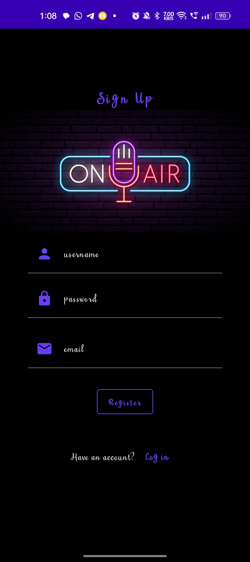
OUTPUT:

Slide 23
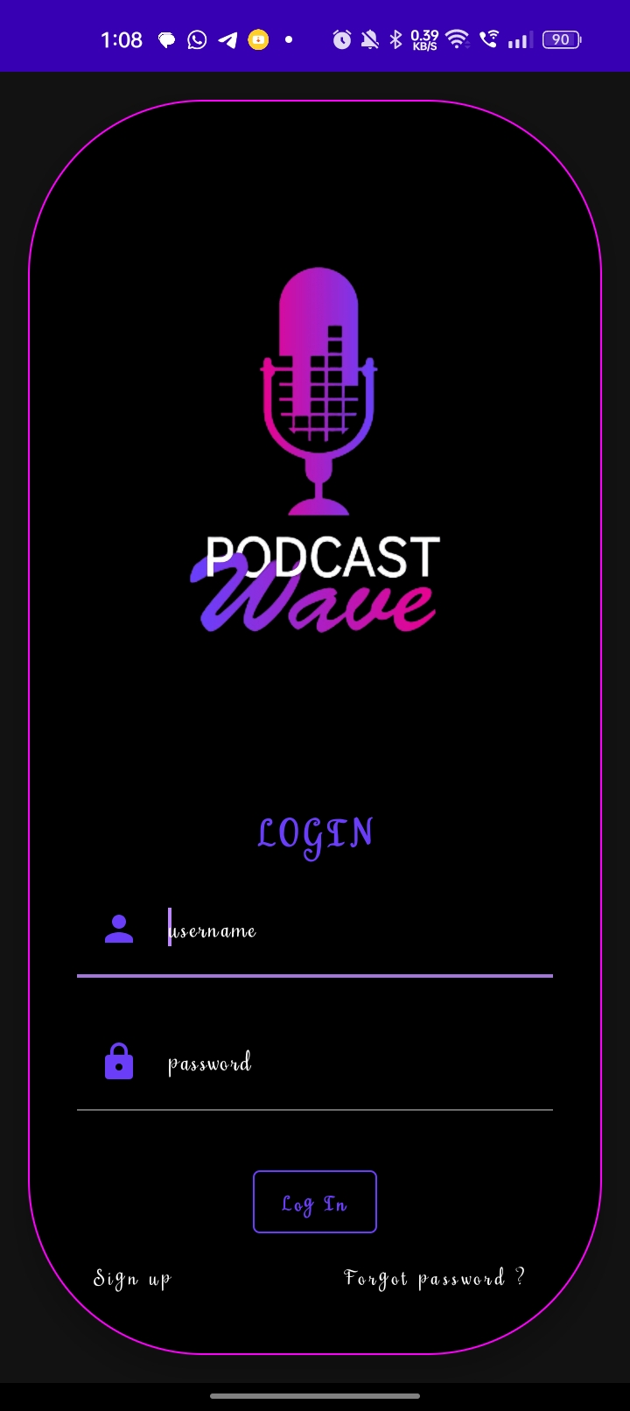

Slide 24
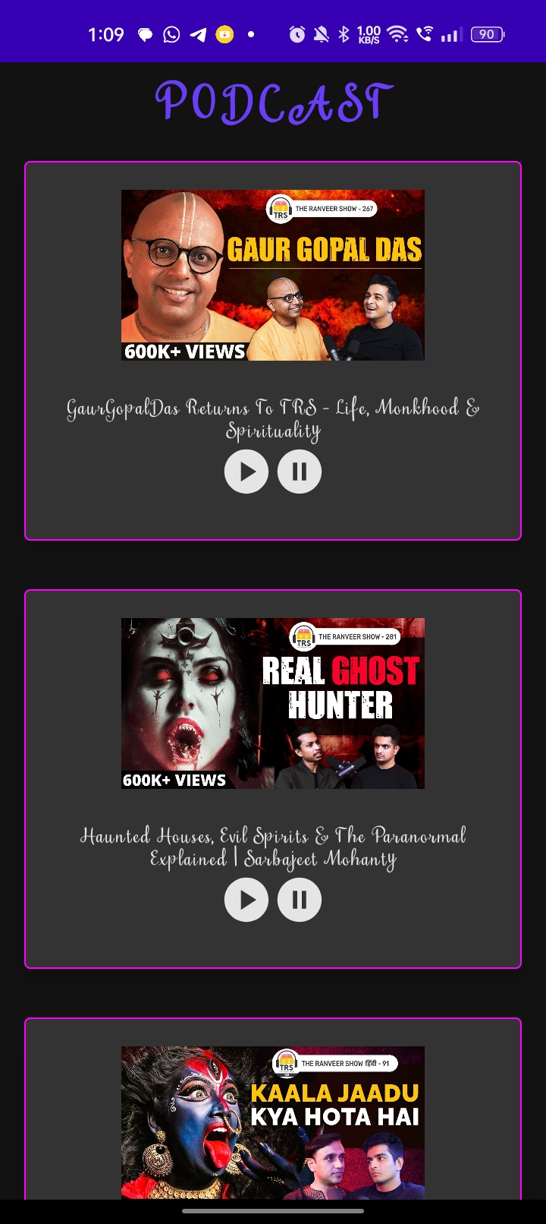

Slide 25
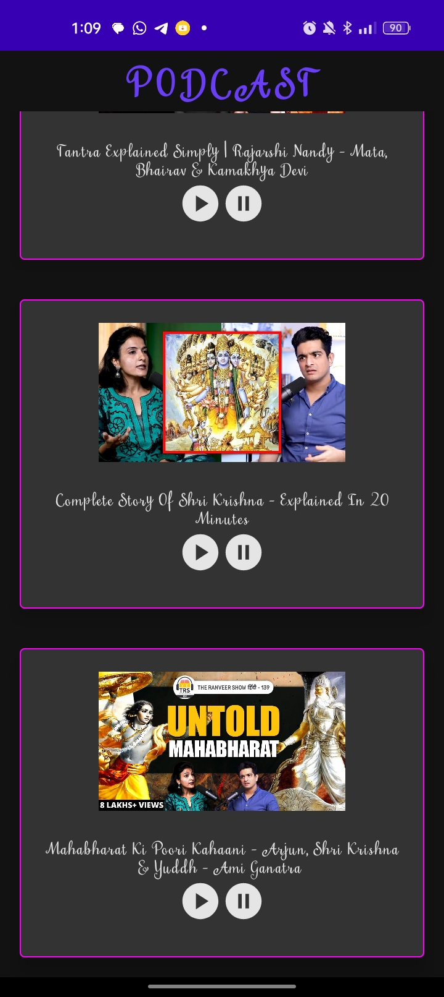

Slide 26
Conclusion
The completion of Podcast Plus: A Redux-Inspired Podcast App with Dynamic Themes for Android represents a significant achievement in enhancing the podcast listening experience. By incorporating Redux-inspired state management and dynamic theming, the app delivers seamless performance while allowing users to personalize their interface, creating a unique and engaging platform. This project showcases the synergy between modern design principles and robust development methodologies, offering a solution that is both functional and visually appealing. With its innovative approach, Podcast Plus sets a new standard for podcasting applications, blending technology and creativity to redefine how users interact with their favorite content.

